Slide 1

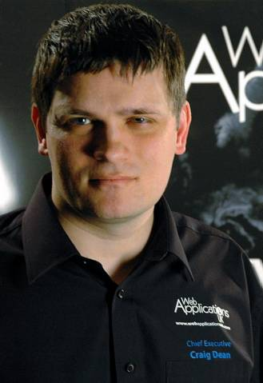






Delivering code as a team
Chief Executive of Web Applications
Oldham President of
Greater Manchester Chamber of Commerce
Craig Dean
Notes:
Welcome, thank everyone for coming.
* Craig Dean
Chief Executive Web Applications UK – employing 70-100 staff developing software for Travel Industry.
Microsoft Gold Partner with 2 gold competencies and 12 silver competencies.
20 MCPS, 22 MCTS, 7 MCITP, 1 MCPD
* Oldham President of the GMCC
* Chair of Governors at Oasis Academy
Governor of Waterhead Academy
Governor of Oldham College
* .NET developer and Microsoft Certified Professional Developer
Writing and developing code since I was six years old, MSc King’s College Cambridge
Stay to the end as will be explaining where you can find jobs.
We’re going to be talking about working together in a business to deliver code to customers.
I’ll use a mixture of slides and hopefully we’ll get some practical demonstrations working as well.
* (Hides graphics)
Q. When are you entering the workforce?
Knowledge will be out of date!
→What doing after uni?

Slide 2

What are you doing after University?
Dev/
Engineer
  Working for a company dedicated to software development.
Working on your own or as part of a small team.
Large potion of work will be maintenance related.
Normally working for internal clients – i.e. managers.
If using a methodology will probably be Agile (e.g. SCRUM).
  Working as part of an in-house team for a non-IT company.
Support
Burger Flipper
  Working in a non-IT job.
Notes:
There’s a huge range of jobs and roles for IT graduates, more than ever, but let’s start by breaking it down a little – and this is just one way of slicing the pie.
* Tragically, many if not most of you will end up in a non-IT role.
* Of those who remain, the vast majority will end up working for a business where IT is not the primary focus
* Very few will end up working for a dedicated software company
* The fact that you’re here hopefully means your not interested in a career at McDonalds
What does a non-IT in-house team look like:
-Part of small teams (if any)
-Large portion of work will be support/maintenance related
-Mostly working for ‘internal’ clients
-Agile methodologies as work is often undefined with limited pressure on deliverables.
Advantage: pay rises quickly (dependency)
Disadvantage: skills become narrow and dated.
→ Compare with being an engineer

Slide 3
What are you doing after University?
Engineer
Surrounded by other engineers.
Large variety of projects.
Typically customers are external.
Methodologies tend to lean towards traditional Waterfall.
Be an Engineer
Don’t BE A LONER!
Notes:
- Surrounded by other engineers
- Variety
- Working mostly for external clients.
- Waterfall (fixed cost, fixed deadlines).
Disadvantage: Can be sweatshops, pay sometimes doesn’t keep up
Advantage: Variety, skills stay relevant
My advice
* Be an Engineer
Learn your craft, be the best you can be.
* Don’t be a lone developer.
No matter how much the offer, it will ruin you long term.
→ Process

Slide 4


Defining a business
The role of process
Methodologies
Customer
Process
INPUTS
OUTPUTS
Team
Quality
Notes:
Whatever you do in business is ultimately down to taking a set of inputs, and producing something from them.
The bit in the middle is a black box that defines your business.
* And we define the black box with a process.
Processes are unique to businesses, each one is subtly different, and are influenced by numerous factors.
* Arguably the most influential factor is your philosophy and the methodologies you adapt.
- Development methodologies like Test Driven Development, Buddy programming, Peer review
- Project methodologies like waterfall and SCRUM
* The most important influencer though is your customer
- What does the customer need/want.
- Ultimately process must meet the customers need – fixed cost/deadlines
* Quality has a huge impact in shaping processes to ensure consistency and repeatability
* Finally a process is influenced by the people who will deliver it – your team
- Must make clear division of responsibility
There are many other factors, including tool choice, etc.
→ Development/Testing process.

Slide 5

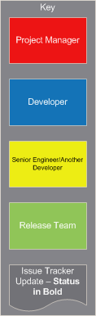
Part of a real progress
Ensuring Quality
Notes:
Issue development process, change requests and bug fixes. (Ignores Project Management, etc.)
This was from >6 months ago and is already out of date (processes evolve).
First notice the key – at some stage a minimum of 4 people are involved in any issue.
(Doesn’t include billing, specification, etc. this is just development)
Starts with development
Unit testing is a fundamental part of development in some projects (.NET, TR4) we use elements of TDD.
Testing is iterative and contributes to test plan extension.
* Skip to peer testing, in the development branch. Code isn’t merged into the release branch until the developer and peer have completed test plans and confirmed it’s fully working and functional.
* Code is merged into release (fully working) and tested again by developer – at this point any conflicts or merge issues are resolved.
If necessary code is redeveloped in dev & release branches.
If a fix isn’t possible the PM can step in and roll out the release.
Once the dev is happy it works in release, the PM reassigns it to a peer tester (often a different one)
* Testing happens in the release branch, at this point it’s a rush, code is either fixed quickly or a roll back will result.
Once both the dev & peer are happy it’s handed off to release. At this point, the release department has it’s own flow diagrams, a number of regression tests are performed, plans are checked etc.
→ Issue tracking

Slide 6






Keeping track of progress
Issue Tracking systems
Bugzilla
PIVOTAL TRACKER
FogBugz
Notes:
Open Source:
* Bugzilla – perl + mySQL (/Oracle), used by Linux, Apache, RedHat, GNOME
* Mantis – PHP + mySQL (/MSSQL/PostgreSQL),
Freemium/Premium
* Jira – by atlassian, good for java.
* Assembla – got quite some traction a few years ago.
* Pivotal Tracker- simple agile, project management focused – integrates into Bugzilla/Jira and others
* FogBugz
→ Demo Fogbugz

Slide 7
DEMONSTRATION
Notes:
Demo FogBugz
https://webapplications.fogbugz.com/default.asp
Username: craig.dean@webappuk.com
Password:
Search for “Improve code coverage” → 20949
Click Edit and demonstrate “Status”
Admin → Workflows → Select “Default Workflow”
Show types of cases, and how workflows differ between them.
Click “New Case”
Title = “Algorithm to calculate prime numbers in parallel.”
Category = “Internal Development”
Status = “In Development”
Estimate = “30 mins”
Description = “Develop a simple algorithm to calculate prime numbers asynchronously.”
Set working on to new case number
Talk to Jeff and let him know case number.
→ Source control

Slide 8



On my own
Adding people ruins it
Lone Wolf
Webbiepedia
Webbiepedia (backup)
Webbiepedia (v2)
The hired help
Notes:
Let’s look at actually writing code.
Recent graduate decides to create his alternative to Wikipedia and build a new uber-app called Webbiepedia (patent pending).
* Developer working on his own create a new project
* Starts writing some code – places in a folder on his hard drive and get’s to work
* Creates a backup
Eventually he gets a stable version and releases it to the world, but then some feature requests come in
* Creates a copy of the original project and starts working on v2.
Webbiepedia starts taking off so he hires another developer, and things get messy,
* so he buys a server, and moves his code onto it.
* Now our developers can access the same code and work on it.
Very quickly though our 2 devs fall out because “Lone Wolf” changes a whole bunch of files and overwrites “The hired help”’s awesome new widget.
So they agree who will work on which file when and they
* indicate this by locking files by making them read only on the server when they’re working on them, and copying them locally.
This gets a little clunky so they invest in a tool to make it a little easier
* Visual Source Safe was originally very lock based, where to work on a file to grabbed a lock for it, the files were copied locally for working on but were backed up on a server.
Source Safe not only controls who has which lock, but it also keeps a track of every commit that’s been made and allows the developers to look back over them for each file.
This is a simple version control system
→ Resolving conflict

Slide 9


Playing nice in the
Developer Sandbox
Team Leader
Dev 3
Dev 4
Dev 1
Dev 2
Notes:
Team grows.
Arguments break out over who gets to lock which file.
* Dev 2 goes on holiday
All hell breaks lose because he left a bunch of files locked out.
Files are locked for too long and unnecessarily.
Instead they decided they want to go back to a system where you can edit what you want and deal with conflicts when they occur.
* Replace VSS with a conflict resolution based VCS, could choose Visual Studio Team System,
* or more commonly SubVersion (SVN)
SVN is the pinnacle of centralised VCS (fork from Concurrent Versions System [CVS] which was first written 1984, and itself descended from Revision Control System [RCS] 1982).
At this point our devs are fully source controlled, with powerful tools.
Reliant on a centralised server.
→ Distributed

Slide 10



Everyone a King!
Distributed Version Control
Team Leader
Dev 3
Dev 4
Dev 1
Notes:
The problem with a centralised server is what happens when you lose that server, or you can’t connect to it?
Developers should be able to work in ‘offline’ mode still tracking their versions and developing with frequent commits of changes.
* Why not make all copies of the repository full source control systems and allow developers to choose who or what they merge with.
Sun developed Sun WorkShop TeamWare in the mid-90s which inspired BitKeeper in 1998. This became hugely popular and was adopted by Linus Torvalds (Linux creator) for the Linux Kernal.
BitMover announced in 2005 that they were stopping free access for open source projects and that kicked off a race for replacements.
* Linus wrote the hugely popular Git – the basis of GitHub and migrated the linux kernal onto it – he famously bragged it was written in a week (and it shows!), and for a long time Linus’ anti-Microsoft stance crippled adoption in the enterprise, though this is warming with the move of Phil Haack to GitHub in Dec ‘11
* whilst Matt Mackall created Mercurial, almost identical to Git yet produced at the same time. The tools for it are much more advanced on Windows platforms.
Both systems are now making serious inroads into SVN.
* However, businesses frequently want to have a concept of where the ‘official’ version of the code base is, and this is often placed in the cloud, e.g. GitHub, or (in our case) Kiln.
→ Demo source control

Slide 11
DEMONSTRATION
Notes:
Demo source control
https://github.com/jmechner/Prince-of-Persia-Apple-II
Open VS10
Create new project ‘Console Application’ called ‘AsyncPrime’ in D:\Demo
Save all
Browse to async prime folder.
TortoiseHg → Create Repository Here.. Update .hgignore
Add files.
Add new project ‘Unit Test Project’ called AsyncPrime.Test in D:\Demo\AsyncPrime
Create interface ‘IPrimeProvider’.
Create delegate & eventhandler
Create PrimeProvider class and implement IPrimeProvider
Add parameterless private constructor.
Add readonly static field for Default singleton (Lazy initialised)
private static readonly Lazy<IPrimeProvider> _default = new Lazy<IPrimeProvider>(
() => new PrimeProvider(),
LazyThreadSafetyMode.PublicationOnly);
And accessor property
public static IPrimeProvider Default { get { return _default.Value; }}
Rename unit tests to PrimeProviderTests.
Add Reference from AsyncPrime.Test -> AsyncPrime project
Add ‘IsPrime’ method to PrimeProviderTests
Add ‘TestOnlyPrime’ method to PrimeProviderTests
Enable Ncrunch to run all tests.
PrimeProvider.Default.Start(); will error.
Add new repository to Test-Repositories in Kiln ‘AsyncPrime’.
Click on repository and then copy URL from the top right.
Synchronise.
Assign case to Jeff.
Call Jeff, ask him to finish.
→ What next?

Slide 12





What next?
Preparing for the real world
Work in teams
Contribute to OS projects
CodePlex, GitHub, SourceForge, Google Code
Read Blogs
Engadget, TechCrunch, Scott Hanselman, Phil Haack
27-28 October @ MOSI – hackmanchester.com
Notes:
* Work in teams
* Contribute to OS projects
* CodePlex (Hg/SVN/TFS), GitHub (Git), SourceForge (SVN/Git/Hg/Bazaar/CVS), Google Code (SVN/Hg/Git)
* Read Blogs
* Engadget, TechCrunch, Scott Hanselman, Phil Haack
* Come along to Hack Manchester
→ Contact us

Slide 13
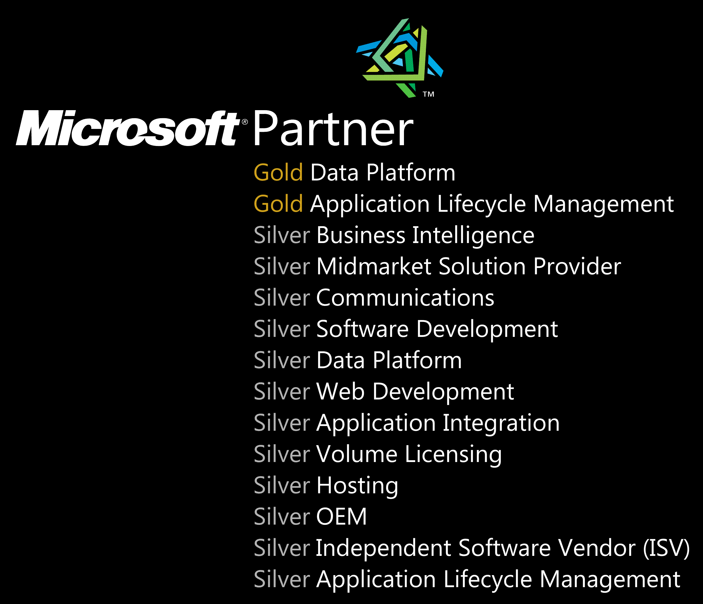

Keep in touch
Contacting us
@UncleThargy
www.webapplicationsuk.com
@WebAppUK
@WAUKCE
recruitment@webappuk.com
Notes:
Contact details
Thargy.com
* www.webapplicationsuk.com
* recruitment@webappuk.com
** SLIDE END **

